Slide 1

Urban v. Rural by Paul, Souzane, & Chidi

Slide 2
Agenda
Introduction & Overview
The Process (Part II) – Analysis
Conclusions
Bloopers & Fails
Takeaways/Post Mortem
Questions/Feedback
The Process (Part I) – Exploration & Cleanup

Slide 3
Introduction & Overview

Slide 4
Background
The purpose of this project was to compare an analyze the quality of living between urban and rural America.
It was determined early that we would like to incorporate census data into our project
We tested variables for both urban and rural zip codes to determine whether there is a similarity or a significant difference.
Based on the variables tested, we were able to draw conclusions as to which city type offered the best quality of life.
We believed that urban America offers a much higher quality of life from income, education, and healthcare in comparison to rural America .

Slide 5
Initial Questions Asked
To determine which city type provided the best quality of life we had do determine which variables to test and how to get them:
Our variables and processes were derived from these questions:
Is there a significant difference in the percentage of the population that earns a certain salary?
What comparisons can be made regarding education attainment?
Does access to health insurance vary between urban and rural areas?
How will we determine what is considered urban vs rural?
Where will we source our data from?
Etc.

Slide 6
Data Sources
2016 Census: Demographic data was sourced from the American Community Survey
1
Google Maps API: Paired with Census data, gmaps was utilized to create maps to display comparisons
2
2010 Census: Data used to determine urban and rural zip codes based on percentage
3

Slide 7
The Process (Part I): Exploration & Cleanup

Slide 8
Data Sets
Demographic data was pulled from the American Community Survey (2016) at Census Block Group level (not the Census API).
After formatting Census block group boundaries to JSON files and identifying Census attribute tables, it was determined that ‘Zip Codes’ would be more effective.
Census API wrapper allows for a command for all zip codes for the 2016 American Community Survey.
This made use of the Census API whereas with the Census Block Group, 25 different csv files were required.

Slide 9
Data Sets (cont.)
Using
Using zip codes provided benefits:
Make use of the census API
More data per zip than census block group
Ability to view counties and their rural and urban percentages
Using
Using census block group provided obstacles:
Other data sets that utilized census block group is limited
Highly specific geographic area
Over 200,000 locations
Enough sufficient data is difficult to generate

Slide 10
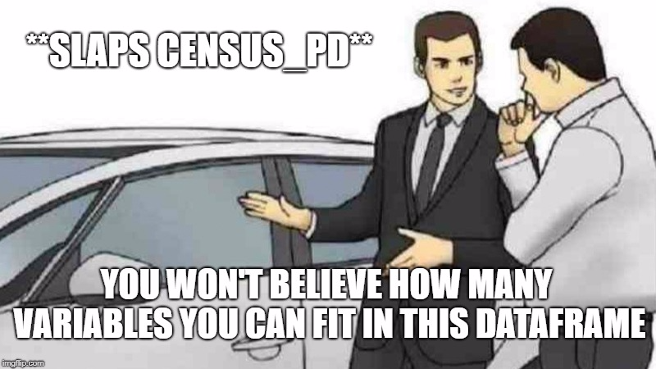

Slide 11
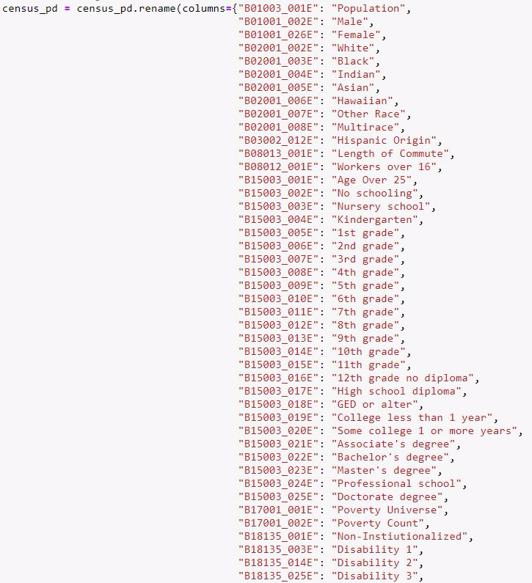
Census API Dataframe

Slide 12
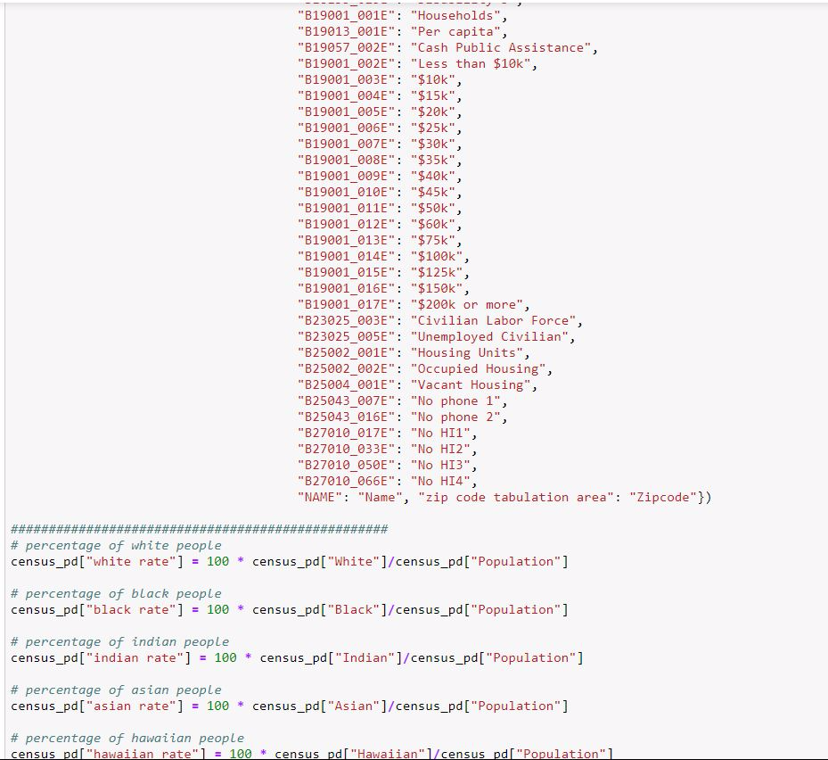
Census API Dataframe (cont.)

Slide 13
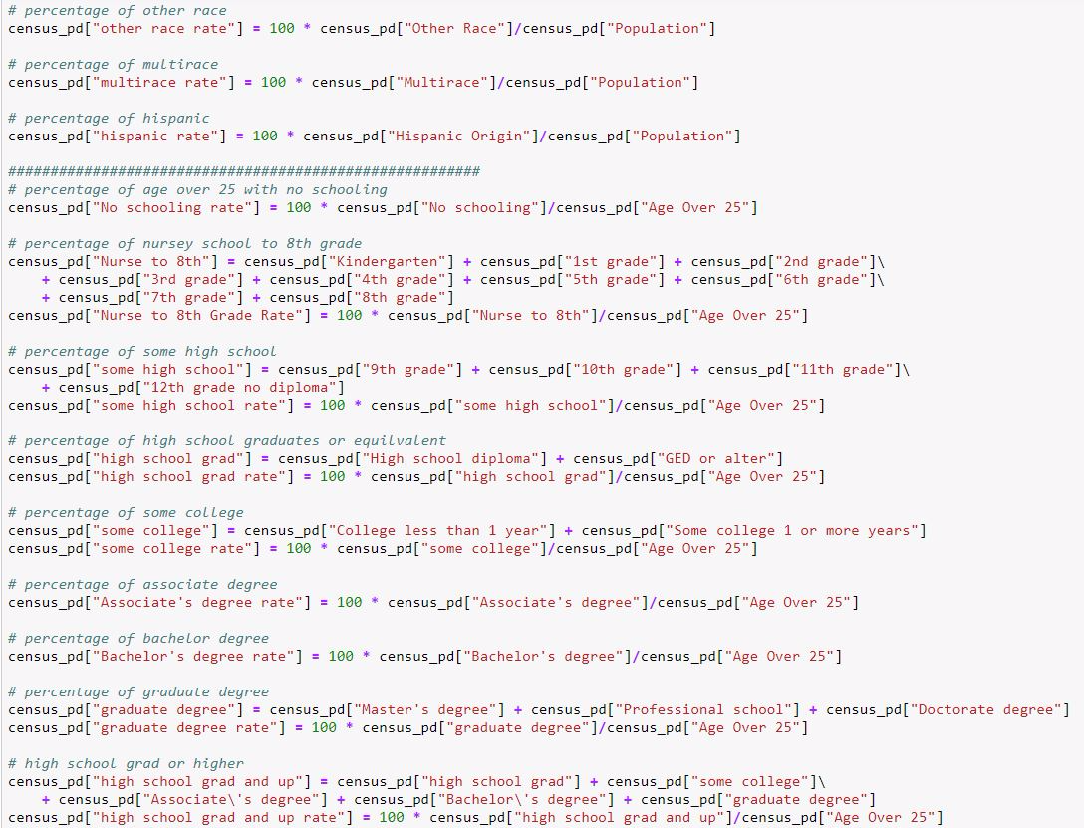
Census API Dataframe (cont.)

Slide 14
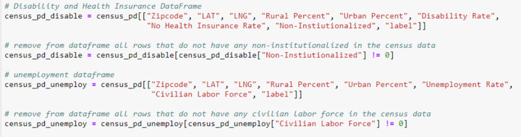
Exploration & Cleanup

Slide 15
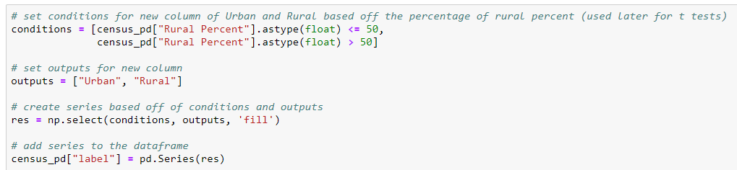
Exploration & Cleanup (cont.)

Slide 16
The Process (Part II): Analysis

Slide 17
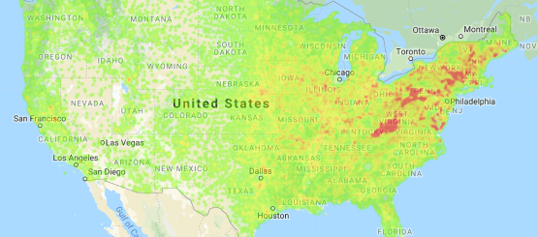
Heat Map: Urban v. Rural Population

Slide 18
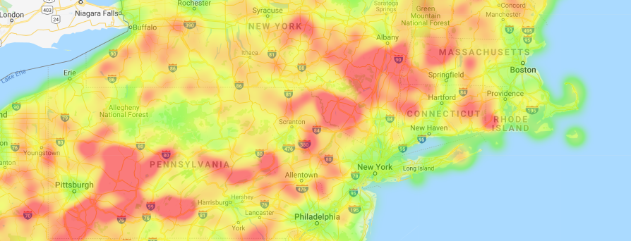
Heat Map: Urban v. Rural Population (zoomed)

Slide 19
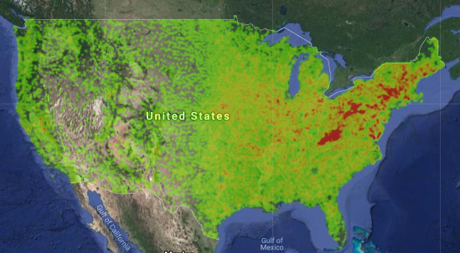
Heat Map: Urban v. Rural Population (satellite)

Slide 20
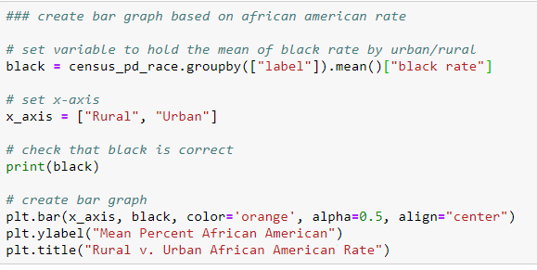
Bar Chart Code

Slide 21
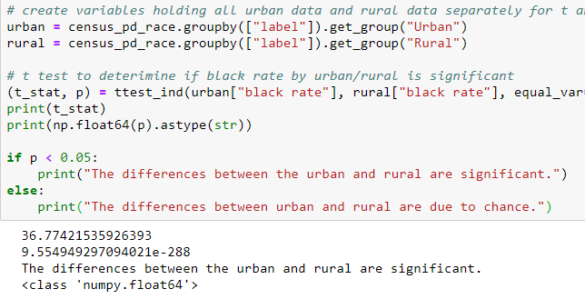
T-Test Code

Slide 22
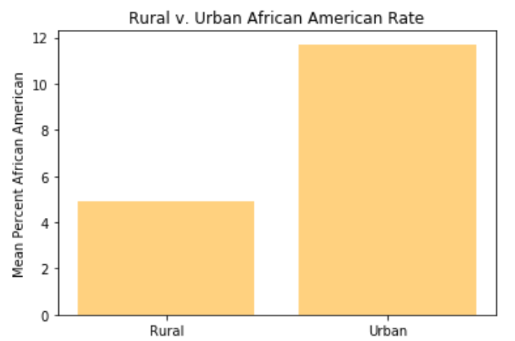
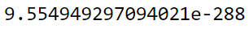
Urban v Rural: African American Population
Rural: 4.92%
Urban: 11.71%
Significant

Slide 23
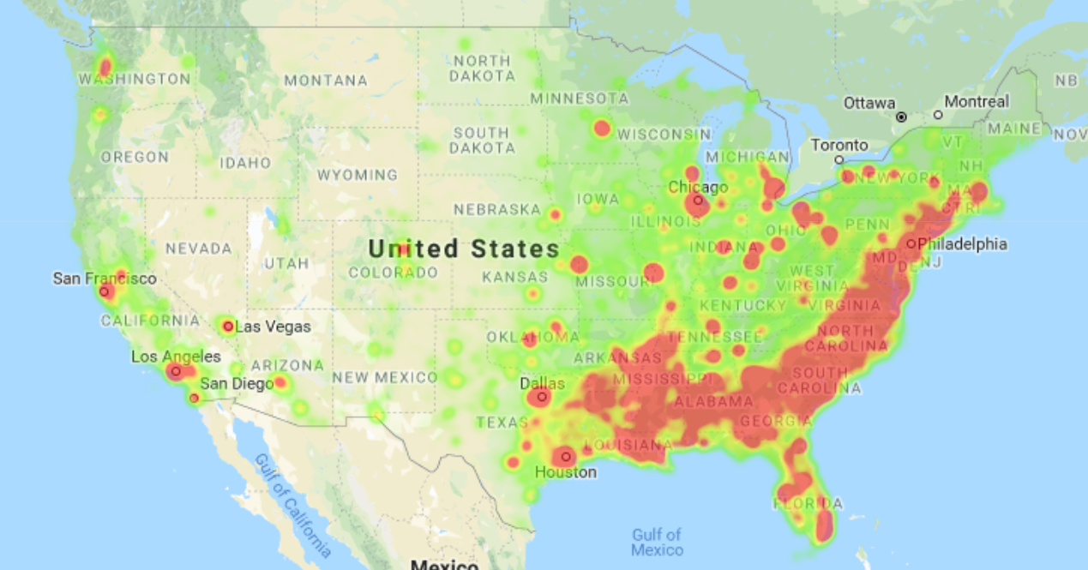
Heat Map: African American Population

Slide 24
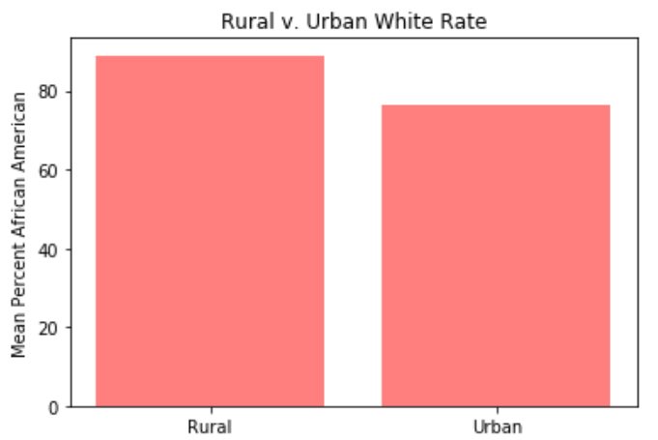
Urban v Rural: White Population
Rural 88.951074
Urban 76.190671
significant

Slide 25
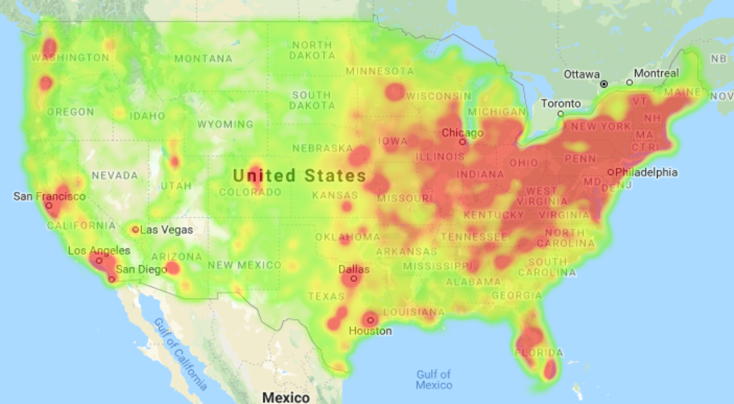
Heat Map: White Population

Slide 26
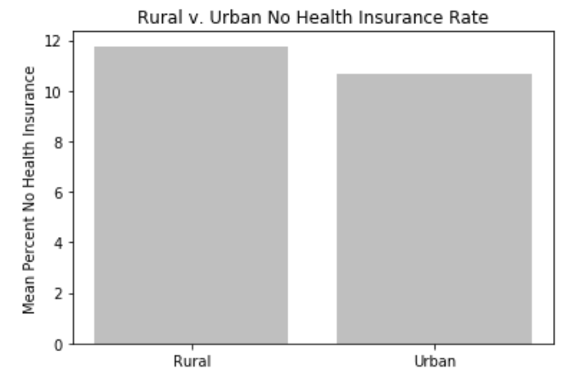
Access to Health Insurance
Rural 11.766129
Urban 10.649247
Significant

Slide 27
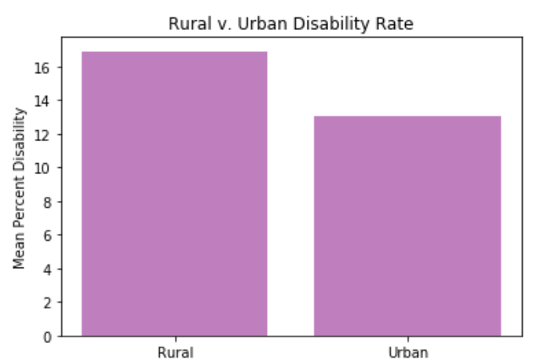
Disability Rate
Rural 16.899750
Urban 13.046824
Significant

Slide 28
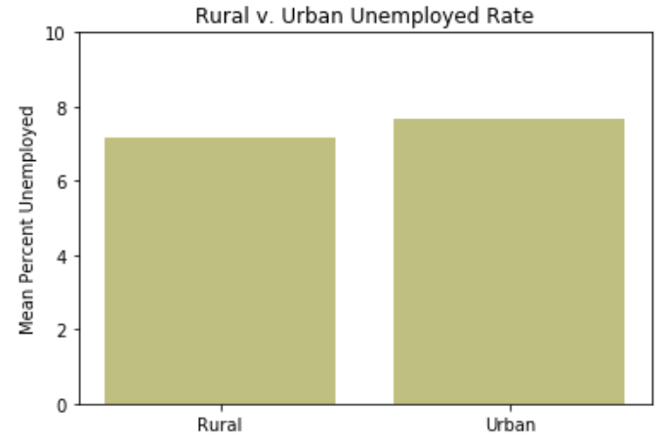
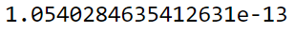
Unemployment Rate
Rural 7.155050
Urban 7.693533
0.54% mean difference still very significant

Slide 29
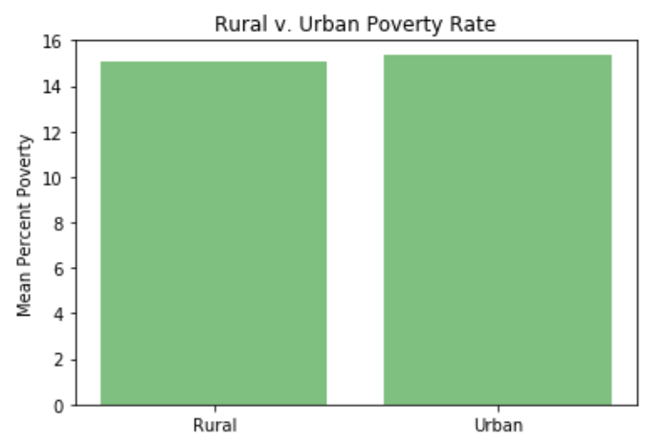
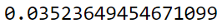
Poverty Rate
Rural 15.058263
Urban 15.341282
Still Significant, if p < .05

Slide 30
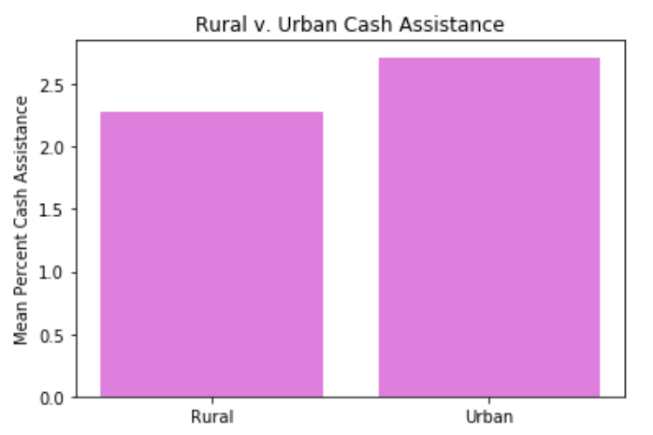
Cash Assistance Need
Rural 2.279046
Urban 2.717072
Significant

Slide 31
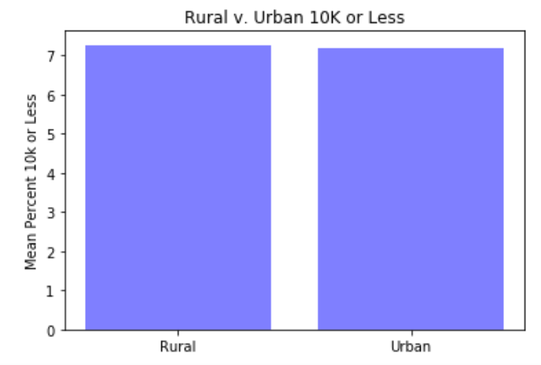
Income: $10K or Less
Rural 7.271844
Urban 7.199502
NOT Significant

Slide 32
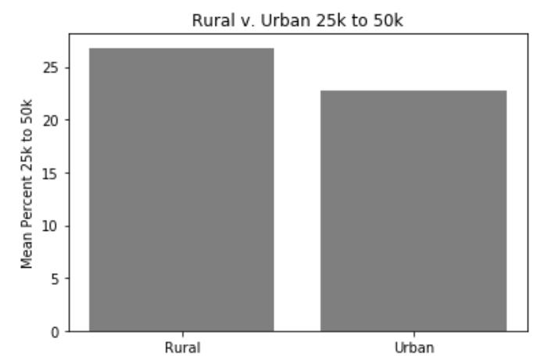
Income: $25K to $50K
Rural 26.790476
Urban 22.801210
Significant

Slide 33
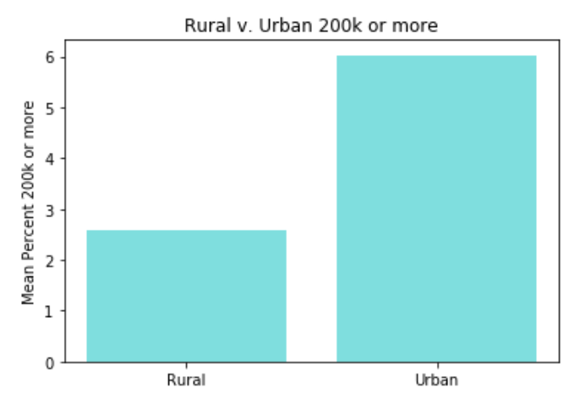
Income: $200k or More
Rural 2.575530
Urban 6.023689
Significant

Slide 34
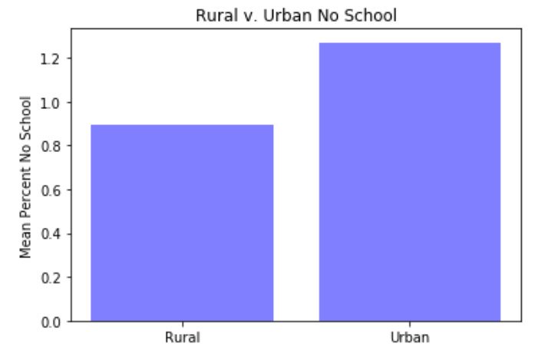
Education: None
Rural 0.894011
Urban 1.271250
Significant

Slide 35
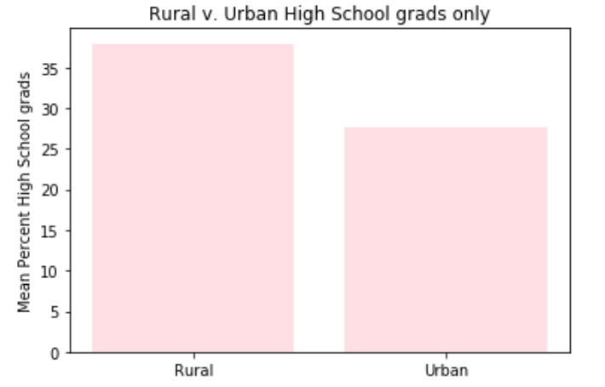
Education: High School Diploma
Rural 37.941760
Urban 27.706044
Significant

Slide 36
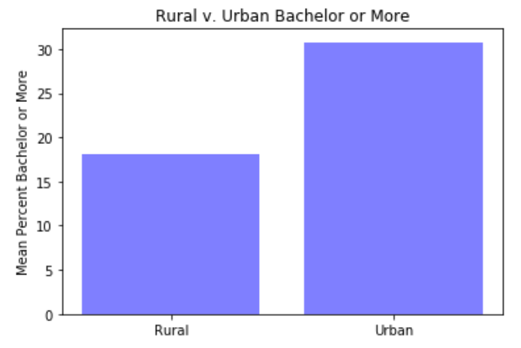
Education: Bachelors or Higher
Rural 18.058370
Urban 30.761606
Significant

Slide 37
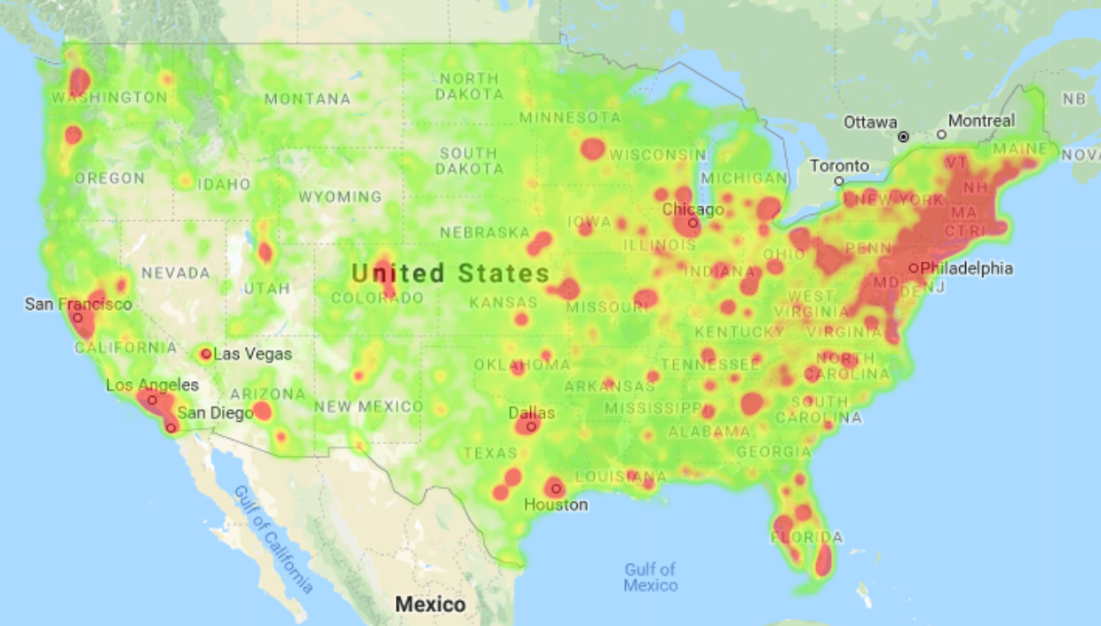
Heat Map: Bachelors Degree

Slide 38
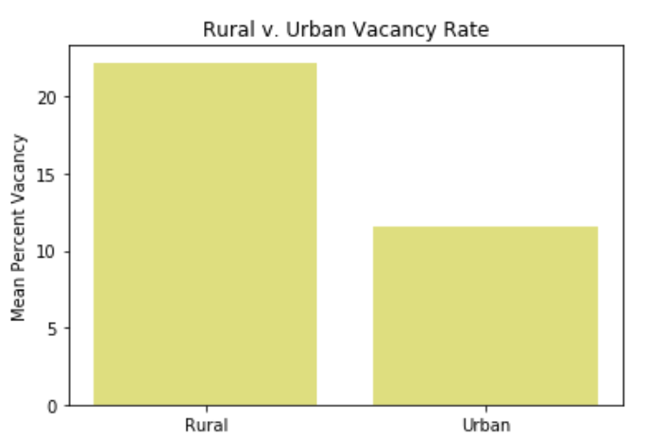
Vacancy
Rural 22.20514
Urban 11.56161
significant

Slide 39
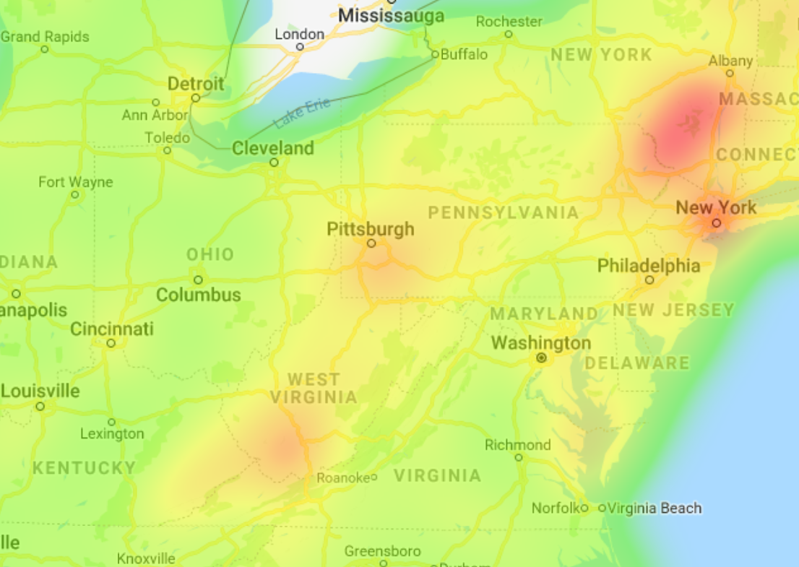
Heat Map: Vacancy (Zoomed)

Slide 40
Final Results/Conclusion

Slide 41
What the Data Tells Us
Urban:
Higher percentage of unemployment and poverty
Higher percentage of education
Higher percentage of income over $200k
Higher percentage of cash assistance need
Lower vacancy rate
Rural:
Lower percentage of unemployment and poverty
Lower percentage of education
Higher percentage of income between $25k and $50k
Lower percentage of cash assistance need
Higher vacancy rate

Slide 42

Bloopers & Fails

Slide 43

Why We Did Not Utilize Scatterplots…

Slide 44
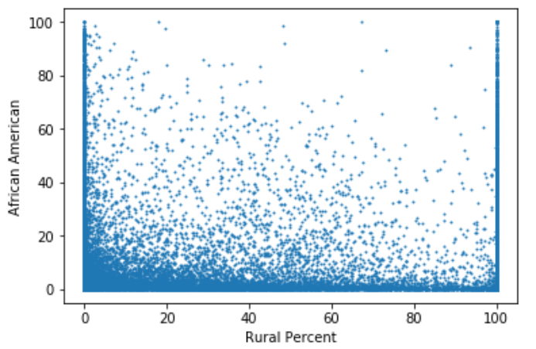
Exhibit A!

Slide 45
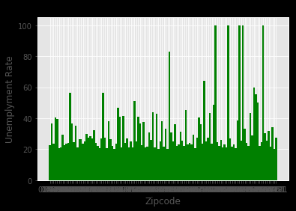
Exhibit B!!

Slide 46
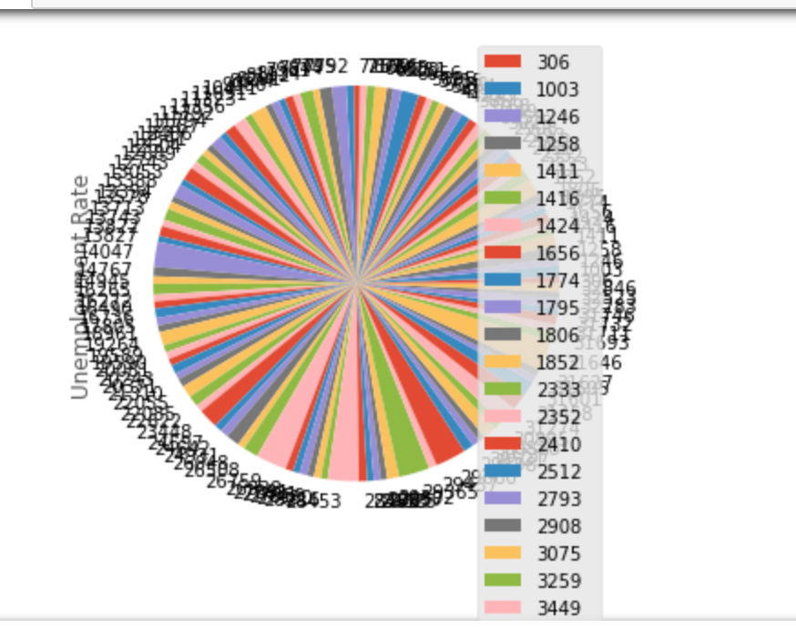
Exhibit C!!!

Slide 47
Takeaways/Post Mortem

Slide 48
What could we test with another week?
Break
1
Break ‘Urban’ and ‘Rural’ into smaller sections (very rural, partially urban, etc.)
Test
2
Test more variables against each other (cost of living vs income vs education)
Get
3
Get a scatter plot to visualize useful data (urban & rural diversity

Slide 49


